Slide 1
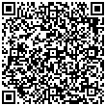
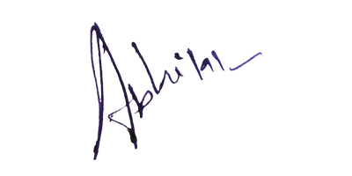
{{QR}}
Certificate of Completion
Siddhant Totade
This is to certify that ___________________________ has been participated and secured
________ rank in Python Programming
contest held on 03/01/2023
1 st
HOD Sign Principal Sign
MU19BTCSE006ET2CSE202304014205

